Slide 1
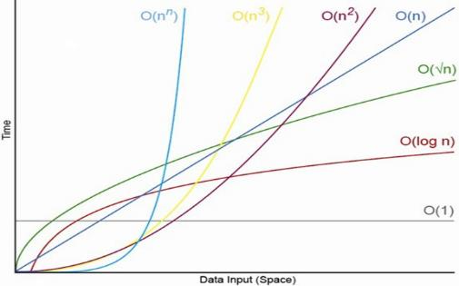
Algorithms and Complexity
Analyzing Algorithm Complexity. Asymptotic Notation
SoftUni Team
Technical Trainers
Software University
https://about.softuni.bg/

Slide 2
Table of Contents
Algorithms
Sorting and Searching, Combinatorics, Dynamic Programming, Graphs, Others
Complexity of Algorithms
Time and Space Complexity
Mean, Average and Worst Case
Asymptotic Notation O(g)
2

Slide 3



Overview

Slide 4
What is an Algorithm?
The term "algorithm" means "a sequence of steps"
Derived from Muḥammad Al-Khwārizmī', a Persia mathematician and astronomer
He described an algorithm for solving quadratic equations in 825
“In mathematics and computer science, an algorithm is a step-by-step procedure for calculations. An algorithm is an effective method expressed as a finite list of well-defined instructions for calculating a function.”
-- Wikipedia

Slide 5
Algorithms in Computer Science
Algorithms are fundamental in programming
Imperative (traditional, algorithmic) programming means to describe in formal steps how to do something
Algorithm == sequence of operations (steps)
Can include branches (conditional blocks) and repeated logic (loops)
Algorithmic thinking (mathematical thinking, logical thinking, engineering thinking)
Ability to decompose the problems into formal sequences of steps (algorithms)

Slide 6
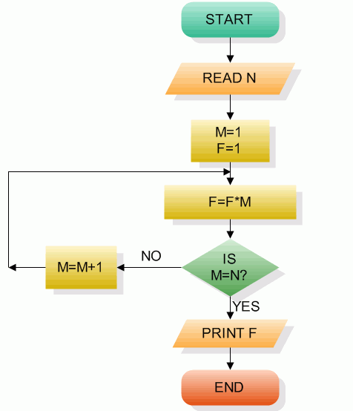
Pseudocode and Flowcharts
Algorithms can be expressed as pseudocode, through flowcharts or program code
BFS(node)
{
queue ← node
while queue not empty
v ← queue
print v
for each child c of v
queue ← c
}
public void DFS(Node node)
{
Print(node.Name);
for (int i = 0; i < node.
Children.Count; i++)
{
if (!visited[node.Id])
DFS(node.Children[i]);
}
visited[node.Id] = true;
}
Pseudo-code
Flowchart
Source code

Slide 7
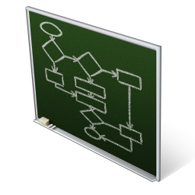

Some Algorithms in Programming
Sorting and searching
Combinatorial algorithms
Recursive algorithms
Dynamic programming
Graph algorithms
DFS and BFS traversals
Other algorithms
Greedy algorithms, computational geometry, randomized algorithms, parallel algorithms, genetic algorithms

Slide 8

Asymptotic Notation

Slide 9



Algorithm Analysis
Why should we analyze algorithms?
Predict the resources the algorithm will need
Computational time (CPU consumption)
Memory space (RAM consumption)
Communication bandwidth consumption
The expected running time of an algorithm is:
The total number of primitive operations executed (machine independent steps)
Also known as algorithm complexity

Slide 10
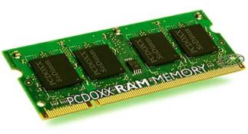
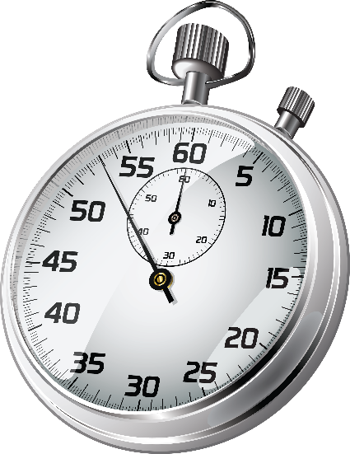
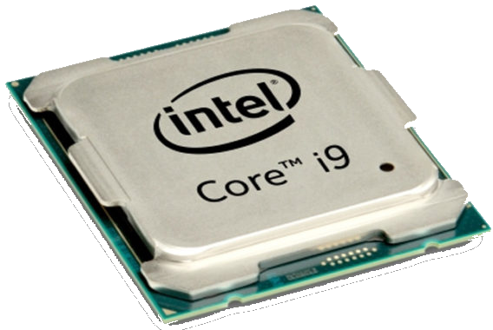
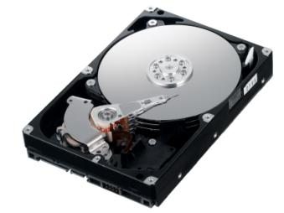
Algorithmic Complexity
What to measure?
CPU time
Memory consumption
Number of steps
Number of particular operations
Number of disk operations
Number of network packets
Asymptotic complexity

Slide 11
Time Complexity
Worst-case
An upper bound on the running time for any input of given size
Typically, algorithms performance is measured for their worst case
Average-case
The running time averaged over all possible inputs
Used to measure algorithms that are repeated many times
Best-case
The lower bound on the running time (the optimal case)

Slide 12

Time Complexity: Example
Sequential search in a list of size n
Worst-case:
n comparisons
Best-case:
1 comparison
Average-case:
n/2 comparisons
The algorithm runs in linear time
Linear number of operations
… | … | … | … | … | … | …
n

Slide 13
Algorithms Complexity
Algorithm complexity - rough estimation of the number of steps of a given computation, depending on the size of the input
Measured with asymptotic notation
O(g) where g is a function of the size of the input data
Examples:
Linear complexity O(n)
All elements are processed once (or constant number of times)
Quadratic complexity O(n²)
Each of the elements is processed n times

Slide 14
Asymptotic Notation: Definition
Asymptotic upper bound
O-notation (Big O notation)
For a given function g(n), we denote by O(g(n)) the set of functions that are different than g(n) by a constant
Examples:
3 * n² + n/2 + 12 ∈ O(n²)
4*n*log₂(3*n+1) + 2*n-1 ∈ O(n * log n)
O(g(n)) = {f(n): there exist positive constants c and n₀ such that f(n) <= c*g(n) for all n >= n₀}

Slide 15
Functions Growth Rate
ƒ(n)
О(n) means a function grows linearly when n increases
E.g.
O(n²) means a function grows exponentially when n increases
E.g.
O(1) means a function does not grow when n changes
E.g.
18
17
16
15
14
13
12
11
10
9
8
7
6
5
4
3
2
1
0
ƒ(n)=n+1
ƒ(n)=n²+2n+2
ƒ(n)=4
n
0 1 2 3 4 5 6 7 8 9 10 11 12 13 14 15

Slide 16
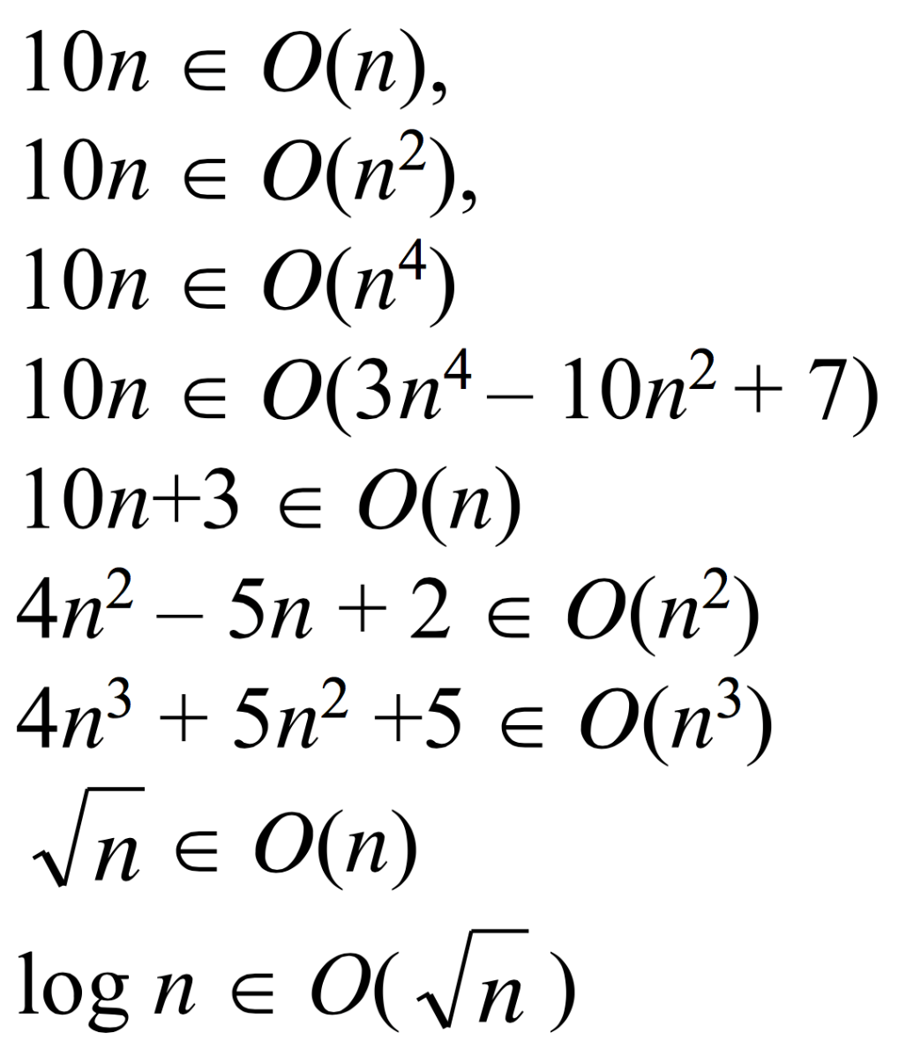
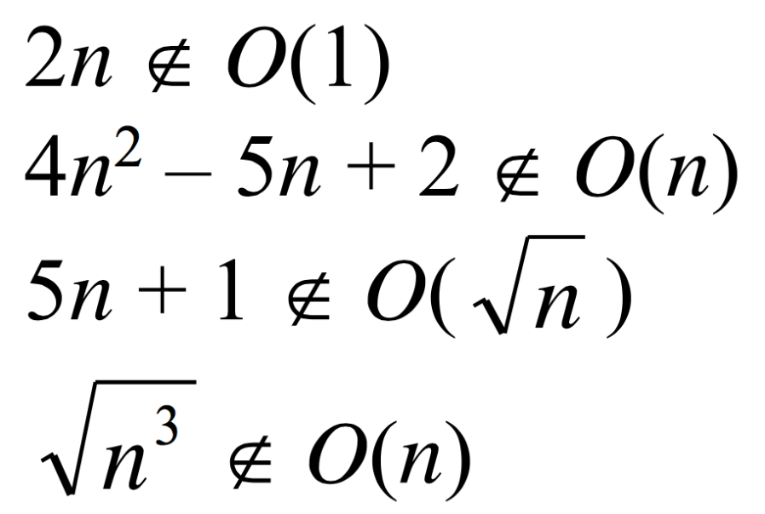
Asymptotic Notation: Examples
Positive examples:
Negative examples:

Slide 17
Asymptotic Functions

Slide 18
Typical Complexities
Complexity | Notation | Description
constant | O(1) | Constant number of operations, not depending on the input data size, e.g. n = 1 000 000 → 1-2 operations
logarithmic | O(log n) | Number of operations proportional to log₂(n) where n is the size of the input data, e.g. n = 1 000 000 000 → 30 operations
linear | O(n) | Number of operations proportional to the input data size, e. g. n = 10 000 → 5 000 operations

Slide 19
Typical Complexities (2)
Complexity | Notation | Description
quadratic | O(n²) | Number of operations proportional to the square of the size of the input data, e.g. n = 500 → 250 000 operations
cubic | O(n³) | Number of operations propor-tional to the cube of the size of the input data, e.g. n = 200 → 8 000 000 operations
exponential | O(2^{n}), O(k^{n}), O(n!) | Exponential number of operations, fast growing, e.g. n = 20 → 1 048 576 operations

Slide 20
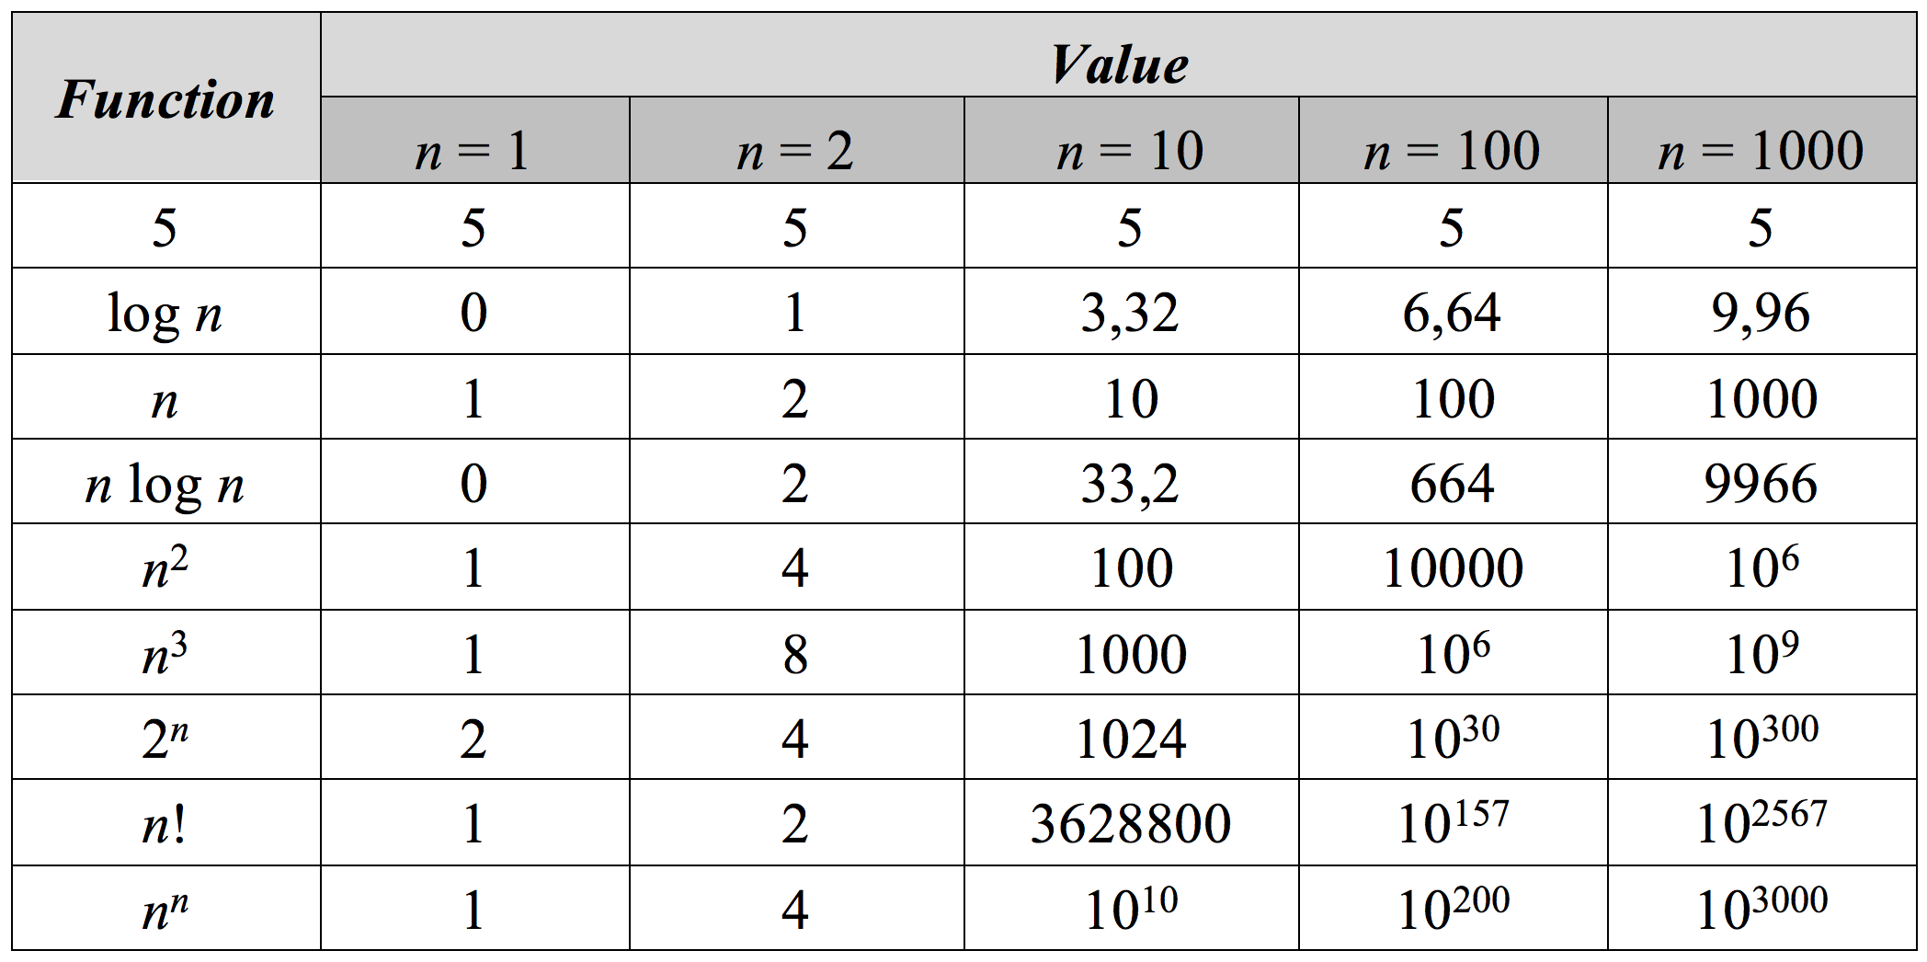
Function Values

Slide 21
Time Complexity and Program Speed
Complexity | 10 | 20 | 50 | 100 | 1 000 | 10 000 | 100 000
O(1) | < 1 s | < 1 s | < 1 s | < 1 s | < 1 s | < 1 s | < 1 s
O(log(n)) | < 1 s | < 1 s | < 1 s | < 1 s | < 1 s | < 1 s | < 1 s
O(n) | < 1 s | < 1 s | < 1 s | < 1 s | < 1 s | < 1 s | < 1 s
O(n*log(n)) | < 1 s | < 1 s | < 1 s | < 1 s | < 1 s | < 1 s | < 1 s
O(n²) | < 1 s | < 1 s | < 1 s | < 1 s | < 1 s | 2 s | 3-4 min
O(n³) | < 1 s | < 1 s | < 1 s | < 1 s | 20 s | 5 hours | 231 days
O(2^{n}) | < 1 s | < 1 s | 260 days | hangs | hangs | hangs | hangs
O(n!) | < 1 s | hangs | hangs | hangs | hangs | hangs | hangs
O(n^{n}) | 3-4 min | hangs | hangs | hangs | hangs | hangs | hangs

Slide 22
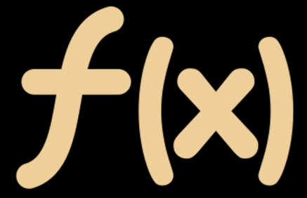
Examples
O(n)
O(n+m)
O(n²)
O(n!)
O(n*m)

Slide 23
Complexity Examples
int FindMaxElement(int[] array)
{
int max = array[0];
for (int i = 1; i < array.length; i++)
{
if (array[i] > max)
max = array[i];
}
return max;
}
Runs in O(n) where n is the size of the array
The number of elementary steps is ~ n

Slide 24
Complexity Examples (2)
long FindInversions(int[] array)
{
long inversions = 0;
for (int i = 0; i < array.Length; i++)
for (int j = i + 1; j < array.Length; i++)
if (array[i] > array[j])
inversions++;
return inversions;
}
Runs in O(n²) where n is the size of the array
The number of elementary steps is ~ n * (n+1) / 2

Slide 25
Complexity Examples (3)
decimal Sum3(int n)
{
decimal sum = 0;
for (int a = 0; a < n; a++)
for (int b = 0; b < n; b++)
for (int c = 0; c < n; c++)
sum += a * b * c;
return sum;
}
Runs in cubic time O(n³)
The number of elementary steps is ~ n³

Slide 26
Complexity Examples (4)
decimal SpecialCalculation(int n)
{
decimal sum = 0;
for (int a = 0; a < n; a++)
for (int b = 0; b < n; b++)
if (a == b)
for (int c = 0; c < n; c++)
sum += a * b * c;
return sum;
}
Runs in quadratic time O(n²) – think why!
The number of elementary steps is ~ n²

Slide 27
Summary
…
…
…
Algorithms are sequences of steps for calculating / doing something
Algorithm complexity is a rough estimation of the number of steps performed by given computation
Can be logarithmic linear, n log n, square (n²), cubic (n³), exponential, etc.
Complexity predicts the speed of given code before its execution

Slide 28
Questions?
Notes:
28

Slide 29
Resources
"Fundamentals of Computer Programming with C#“ ➔ "Data Structures and Algorithm Complexity" ➔ pages 787-798
https://introprogramming.info/wp-content/uploads/2018/07/CSharp-Principles-Book-Nakov-v2018.pdf
29

Slide 30

License
This course (slides, examples, demos, exercises, homework, documents, videos and other assets) is copyrighted content
Unauthorized copy, reproduction or use is illegal
© SoftUni – https://softuni.org
© Software University – https://softuni.bg
Notes:
30

